Slide 1

Hanwash Performance Indicator (H.P.I)
This user guide will help you navigate to this console. And display the features available.

Slide 2
H.P.I console
How to access the console?

Slide 3
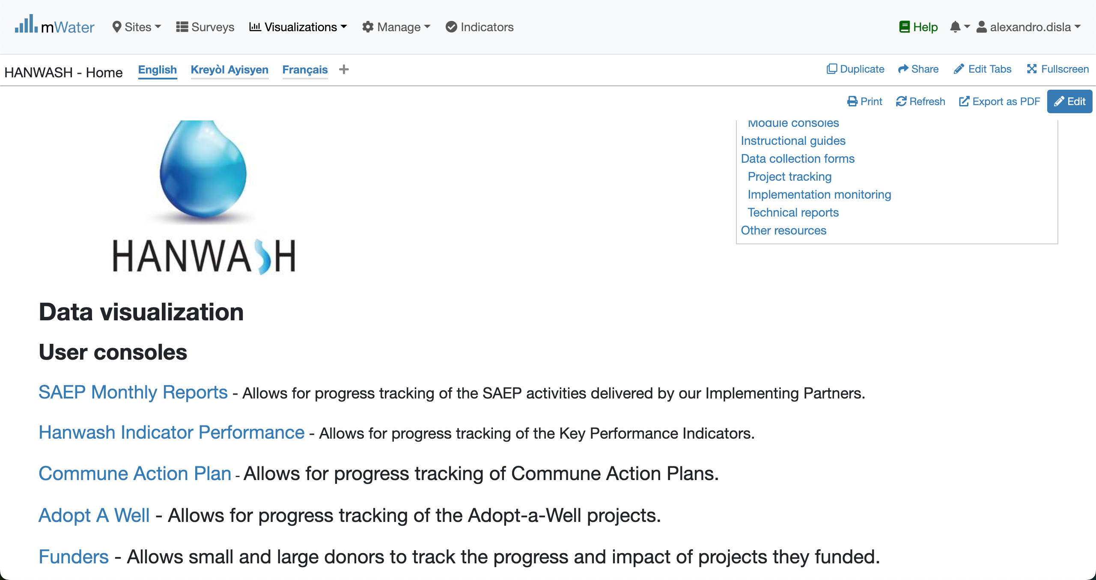
Hanwash HOME
URL LINK : http://go.mwater.co/hanwash

Slide 4
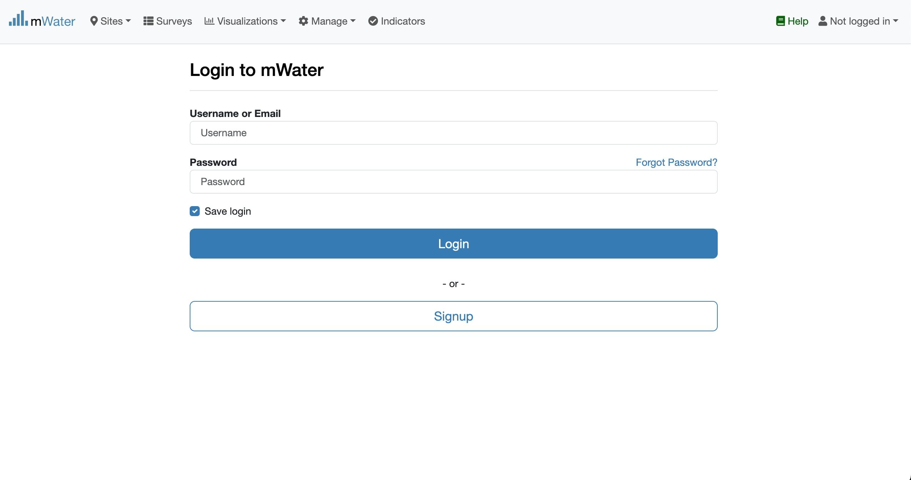
Access The H.P.I Console & Login process
Click on the H.P.I console url link
Please enter your Credentials (username ,console)
Log status indicator

Slide 5

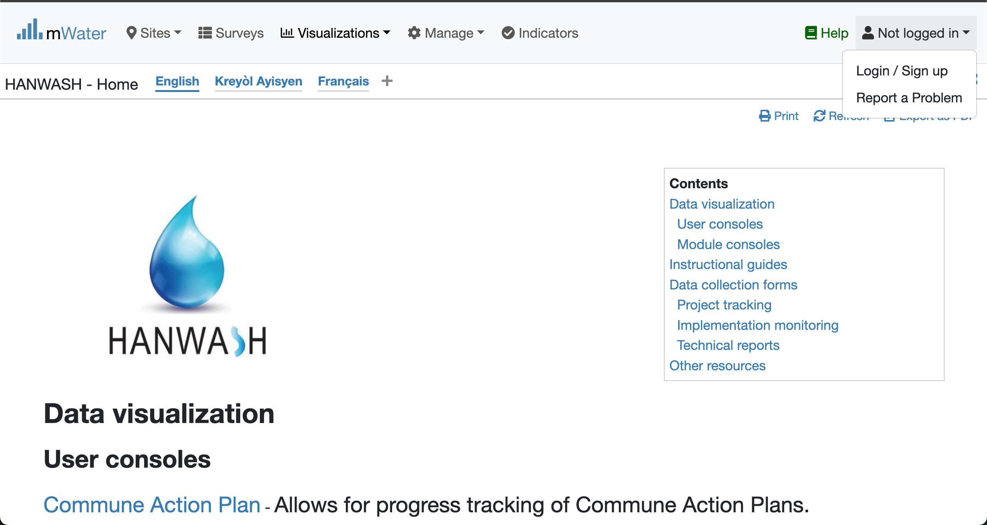

Login Process (2nd scenario)
Click to Login or Signup
Please Click on this selection box
Please enter your Credentials

Slide 6
Console Overview
1. The Introduction (Static)
2. Presentation of the HANWASH indicators
3. Values of the HANWASH indicators

Slide 7
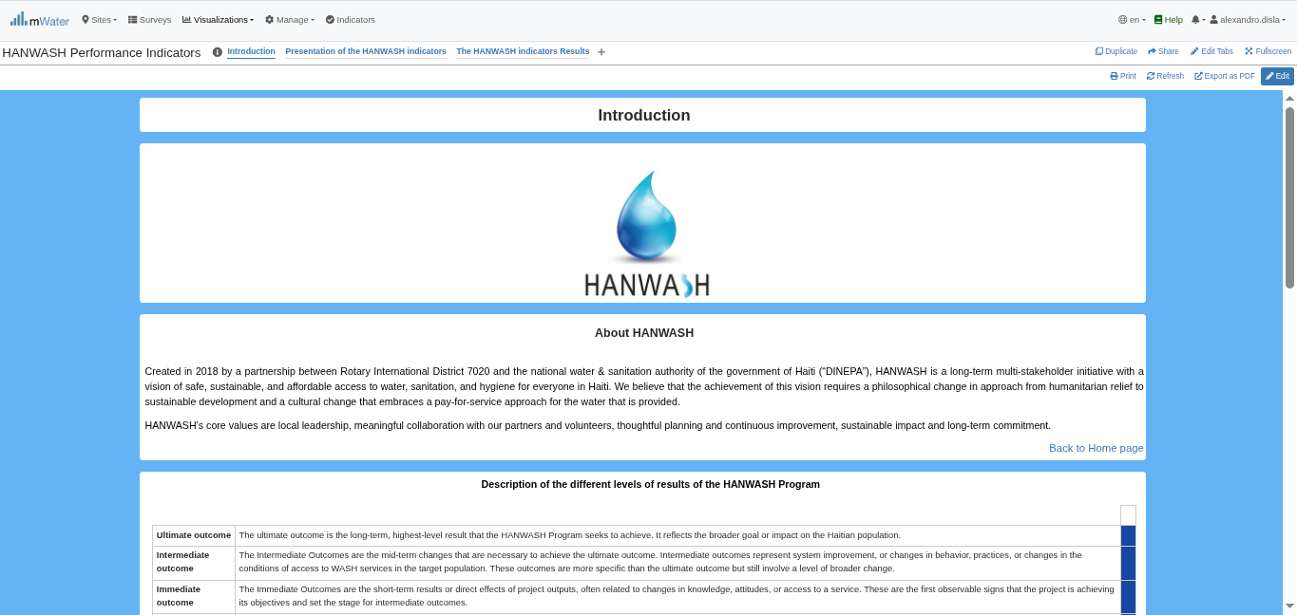
H.P.I Console overview

Slide 8
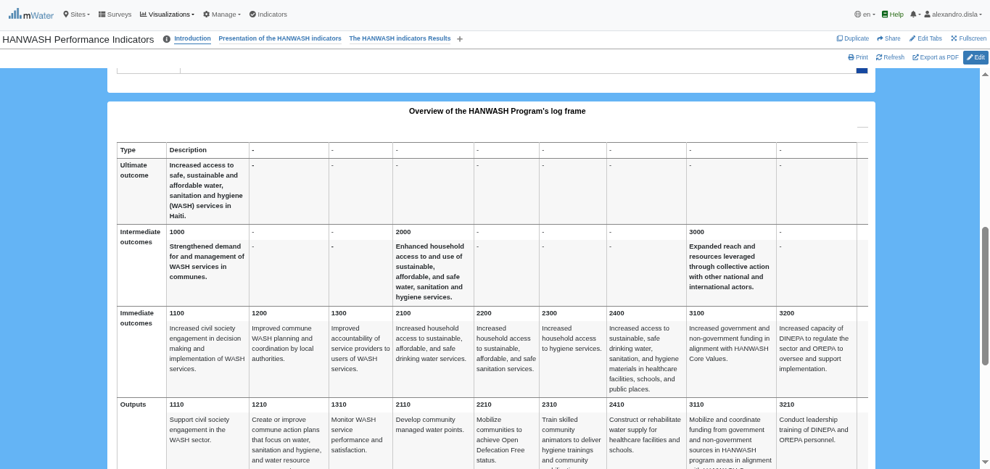
H.P.I Console overview

Slide 9
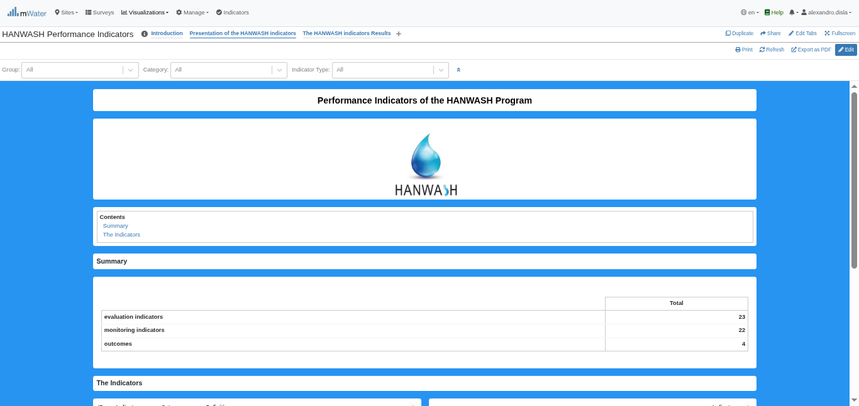
H.P.I Console overview

Slide 10
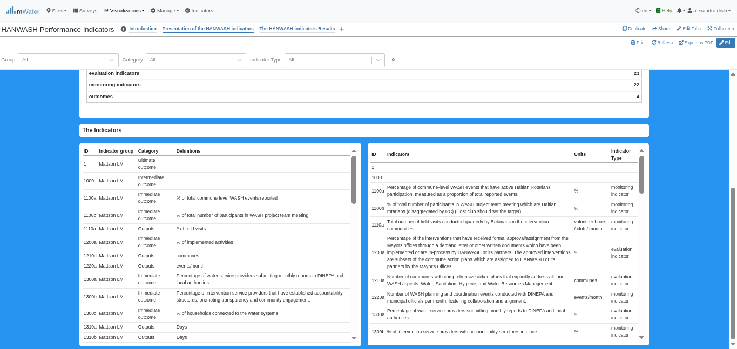
H.P.I Console overview

Slide 11
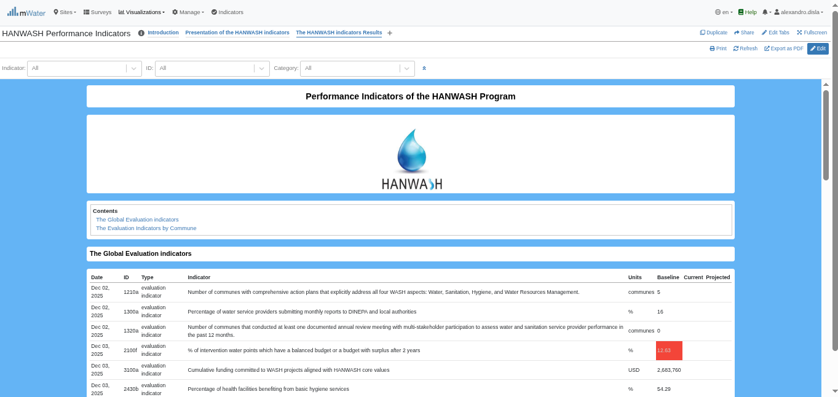
H.P.I Console overview

Slide 12
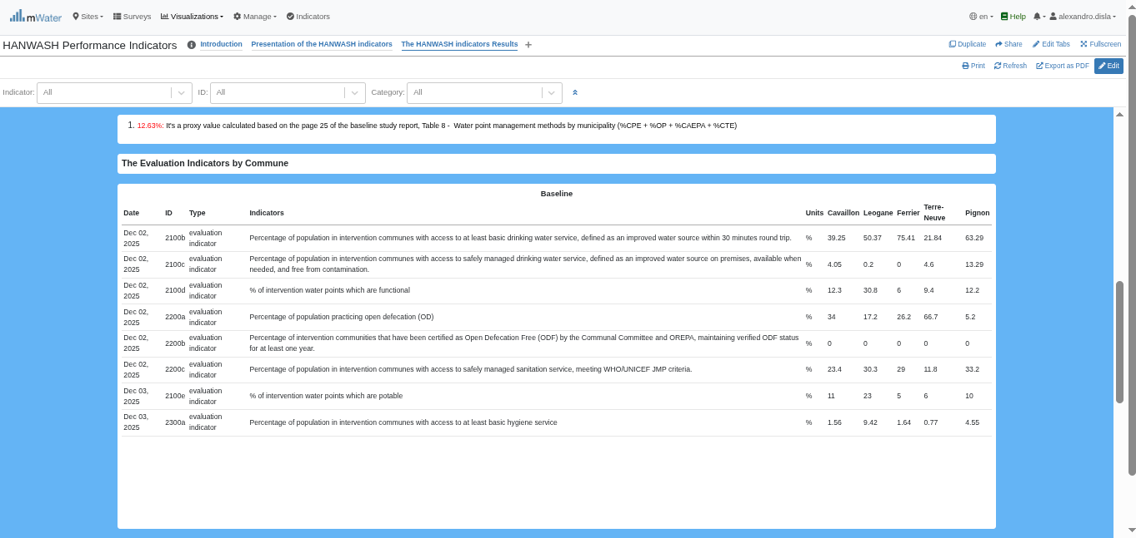
H.P.I Console overview

Slide 13
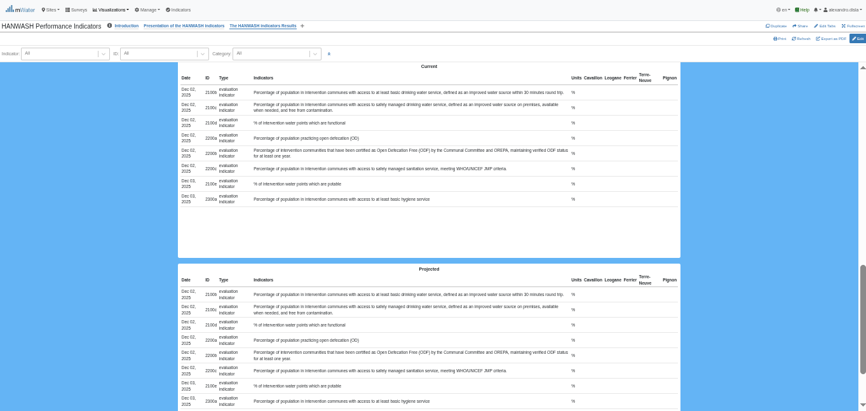
H.P.I Console overview

Slide 14
Functionalities
What are the functionalities available?

Slide 15
The introduction page
Introduction:
About Hanwash
Description of the results levels
The HANWASH PROGRAM LOG FRAME

Slide 16
Introduction

Slide 17
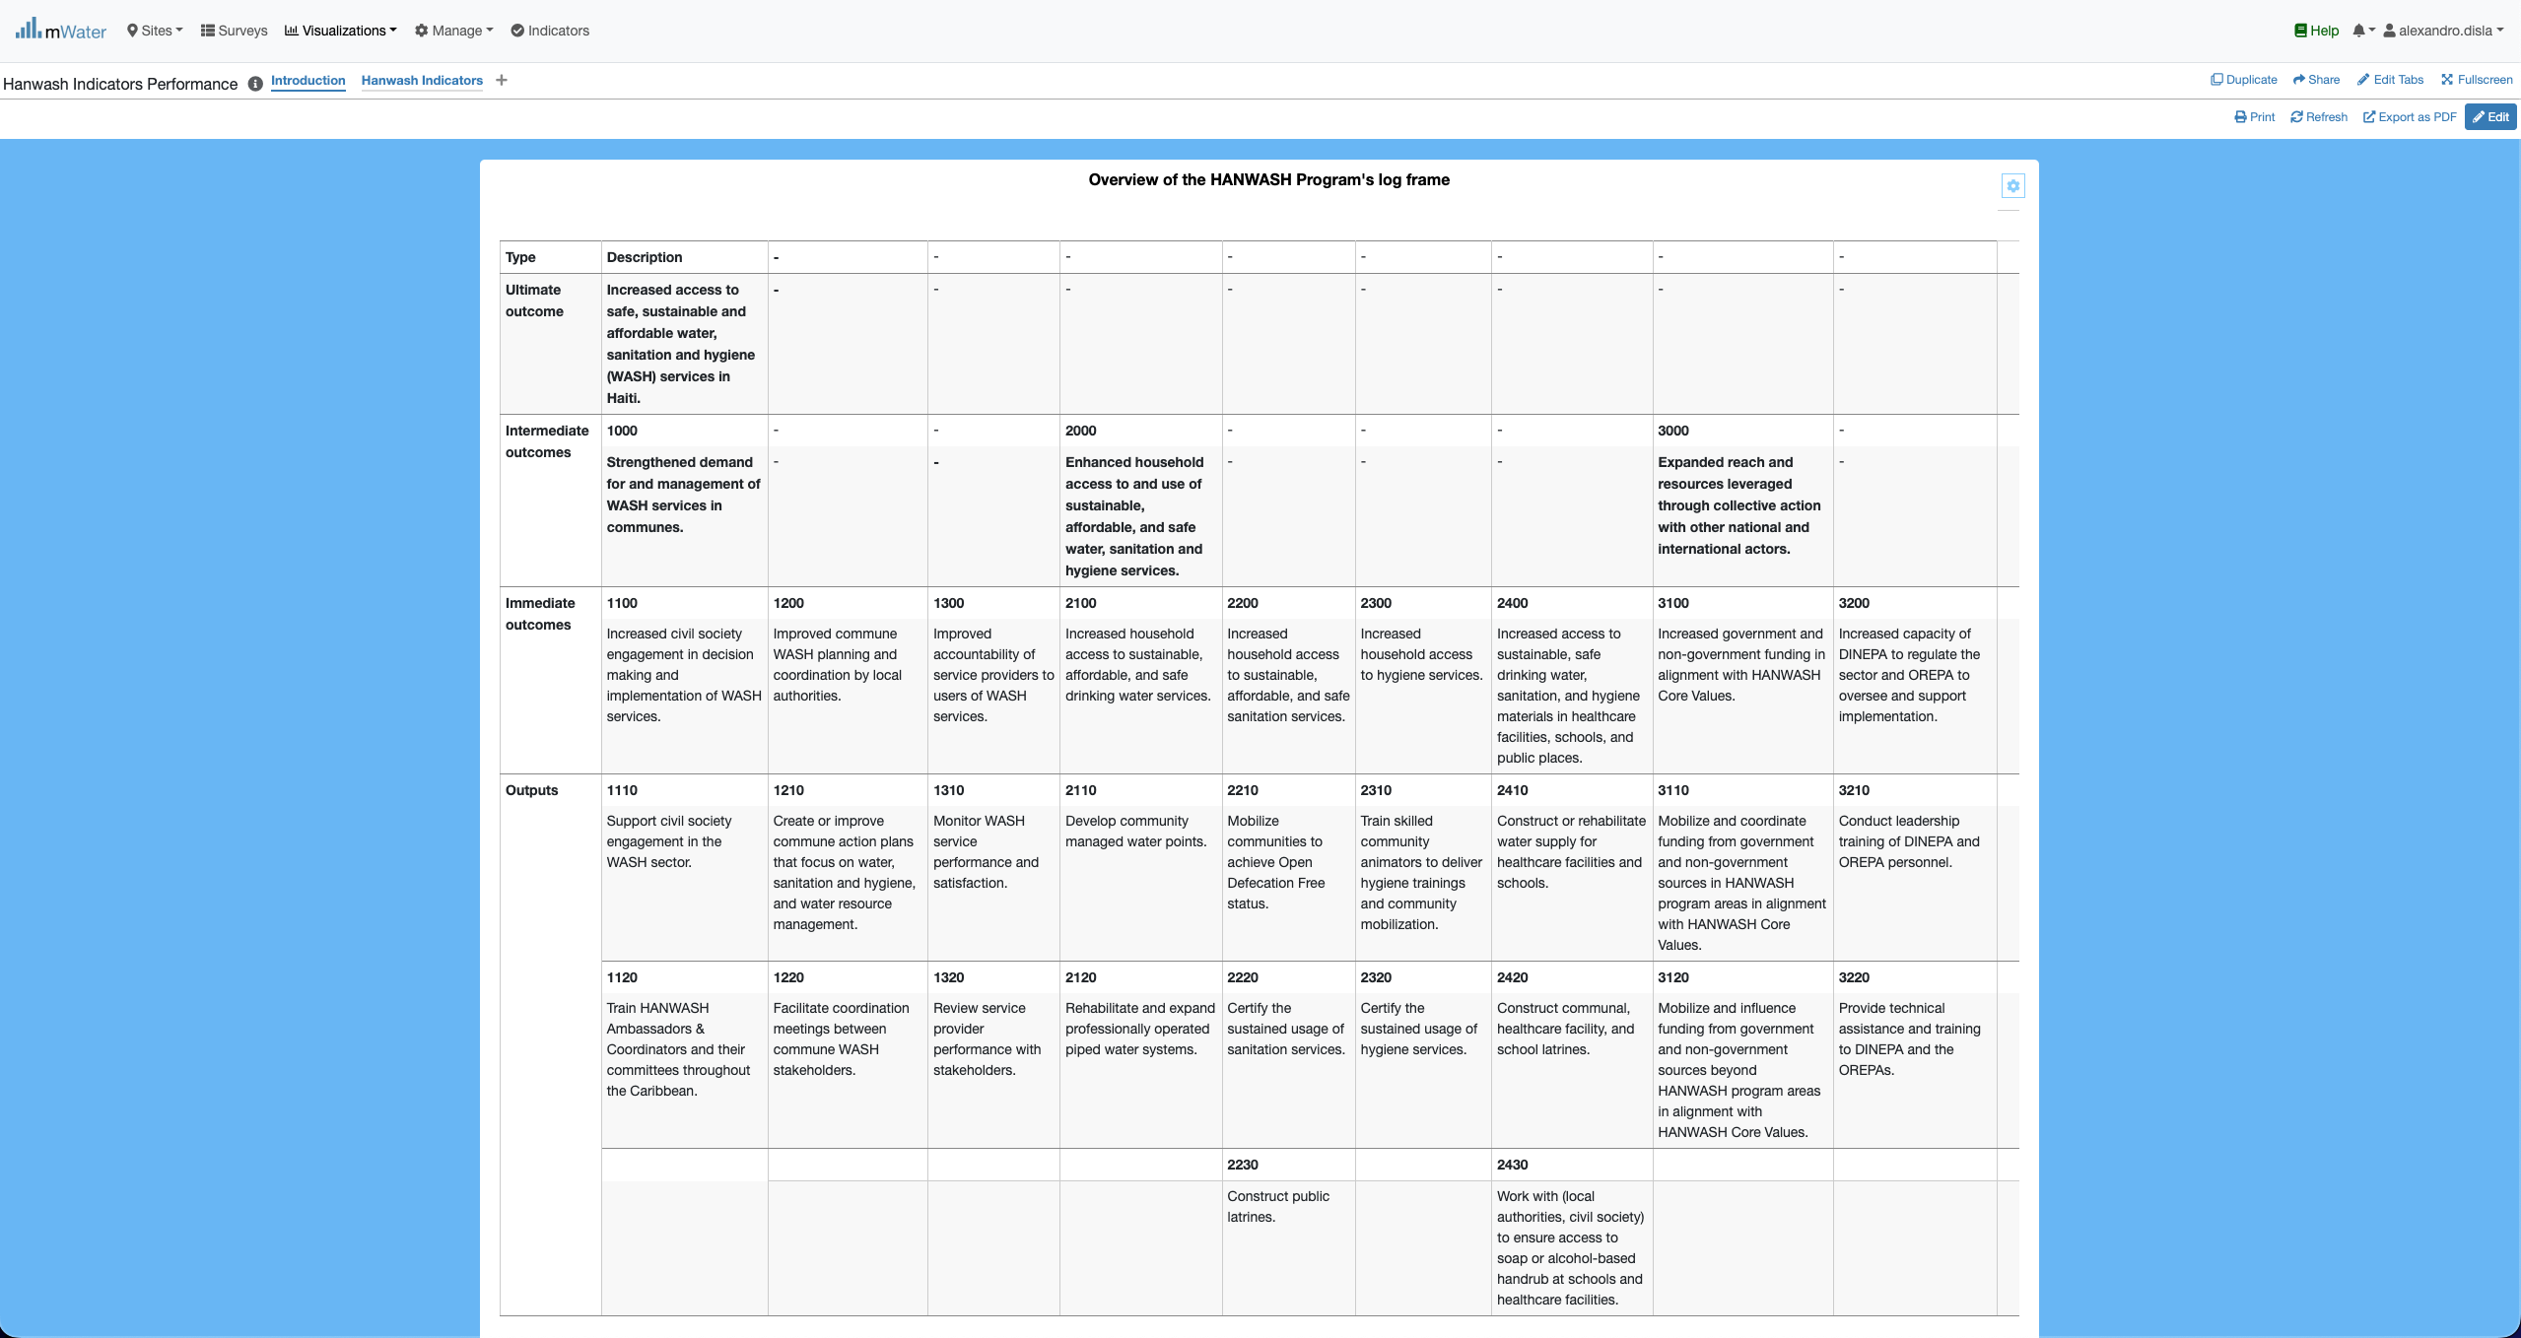
Introduction
The key feature of merge and center is missing from the platform. We have place these yellow box to showcase this.

Slide 18
Presentation of the HANWASH indicators
HANWASHIndicators:
The indicators

Slide 19
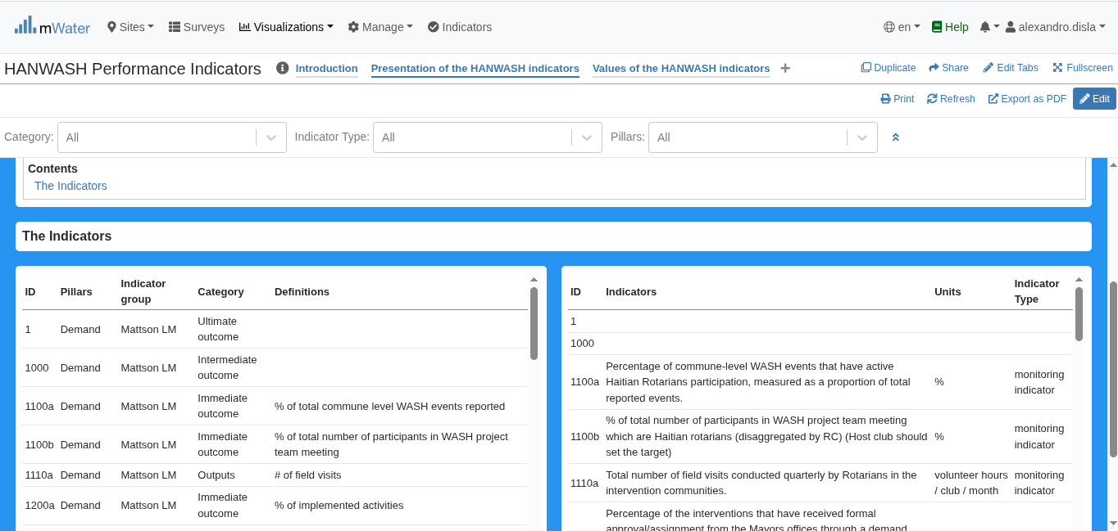
The table view
The table has been cut into two to be more visually pleasing.

Slide 20
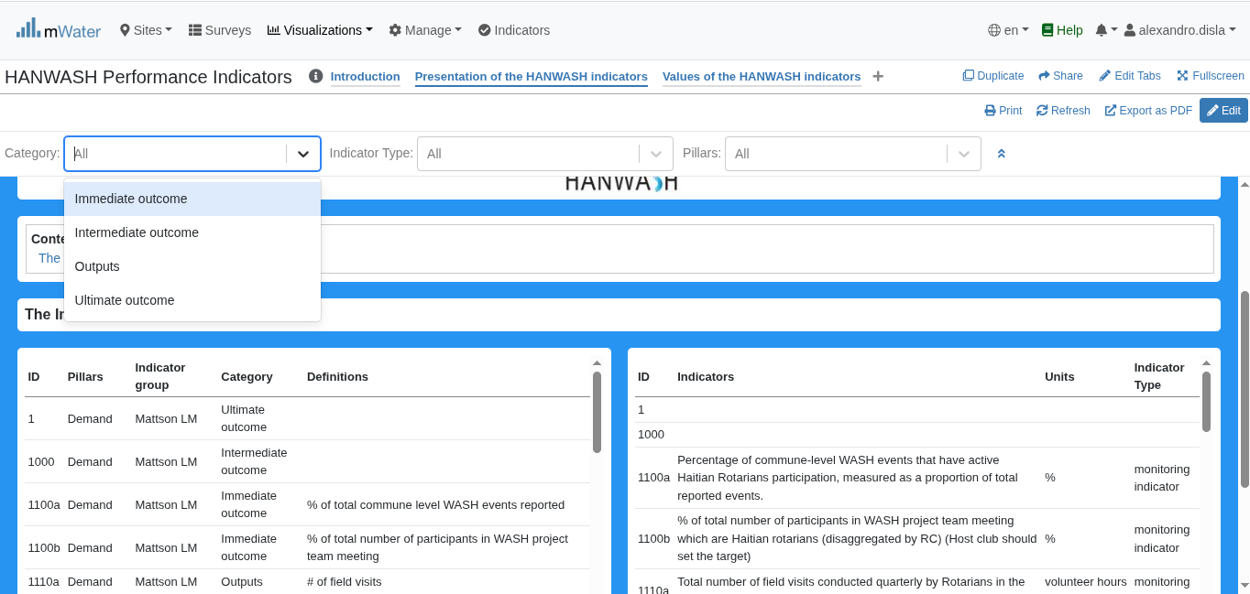
Display the quickfilters
This quick filter allows you to filter the different outcomes. The table will behave accordingly.

Slide 21
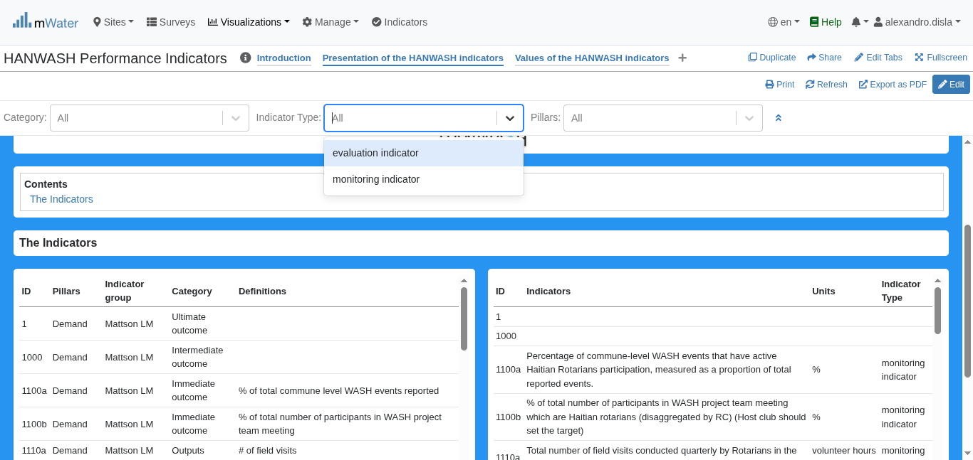
Display the quickfilters
This quick filter allows you to filter the two indicator types. The table will behave accordingly.

Slide 22
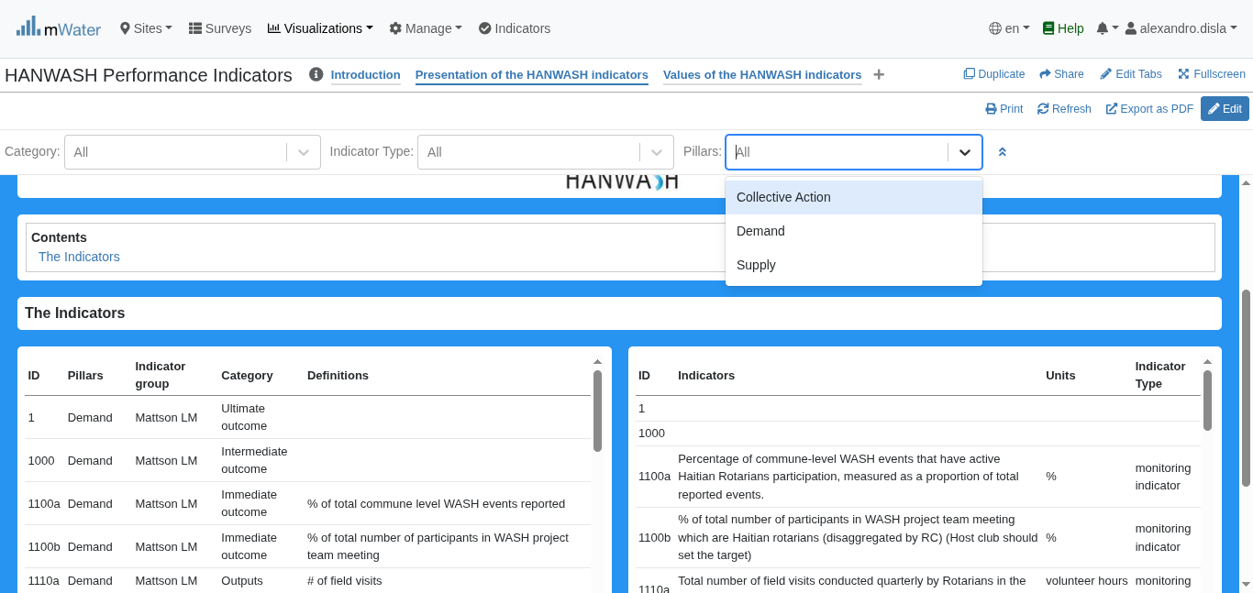
Display the quickfilters
The 3rd filter is the unique ID of the indicator.

Slide 23
Values of the HANWASH indicators
HANWASHIndicators:
Indicators with unique values global for the 5 communes
Indicators disaggregated by commune

Slide 24
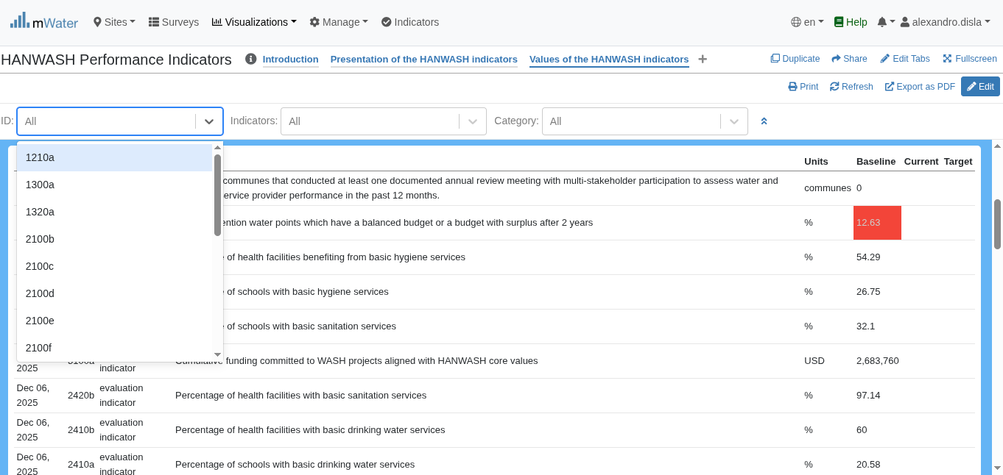
Indicators with unique values
The evaluation indicators are collected either by commune or with a unique value. As indicated in this table we have the unique value for the baseline.
You can filter by the ID of the indicator

Slide 25
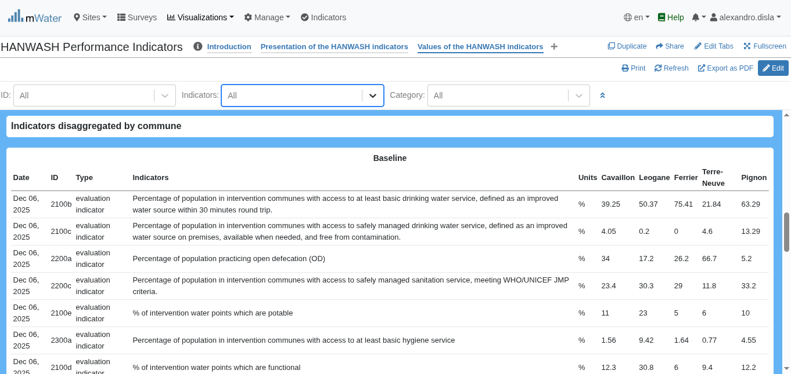
Indicator values by commune
We can filter by the name of the indicators.
We have the baseline values of the indicators by the 5 communes

Slide 26
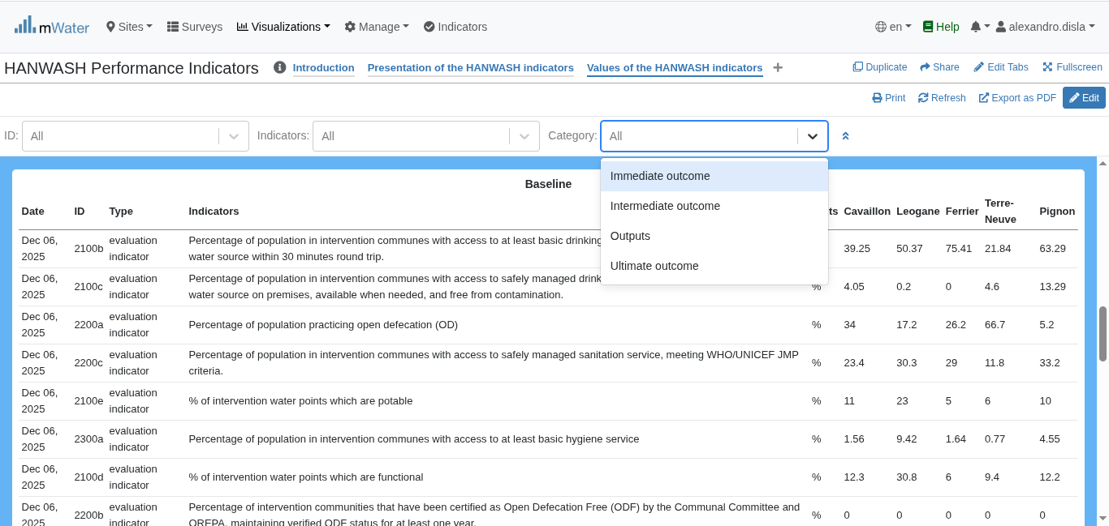
Indicator values by commune
We can filter by category of outcomes.

Slide 27
Export
Export table as you need

Slide 28
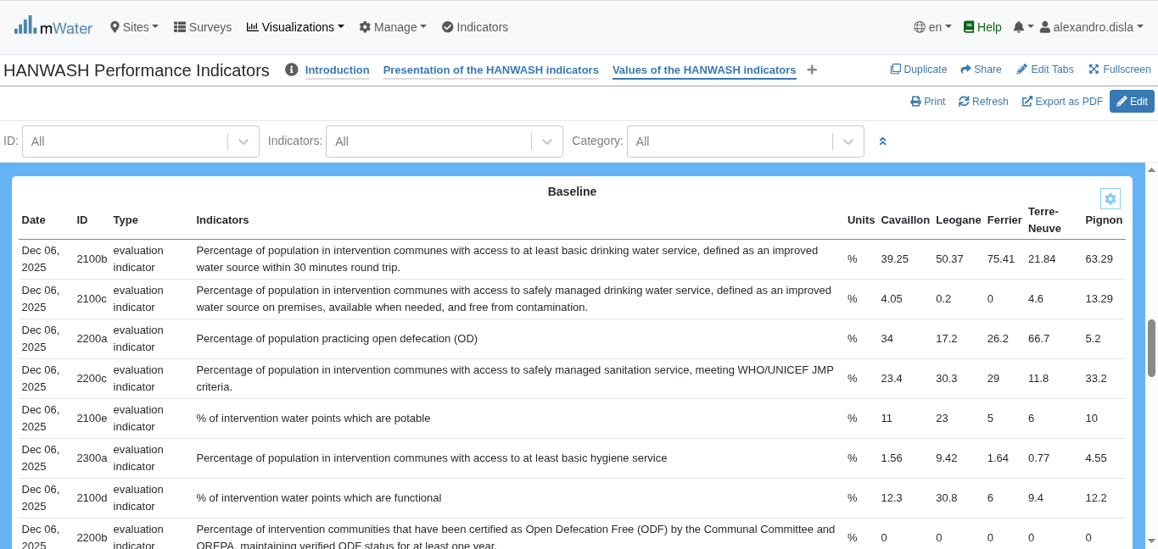
Export Table
This button: Export Data will open a portal.

Slide 29
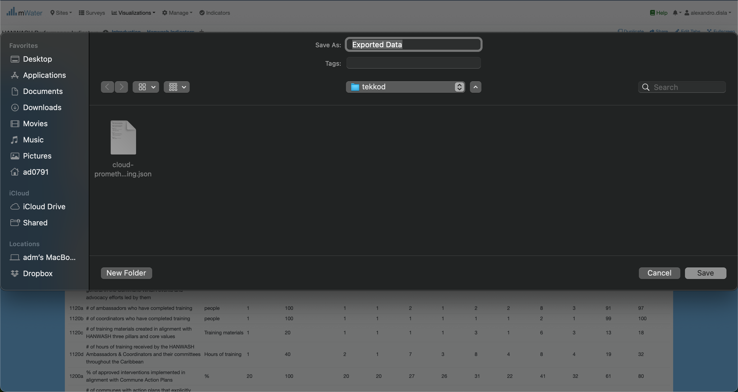
Export Table

Slide 30
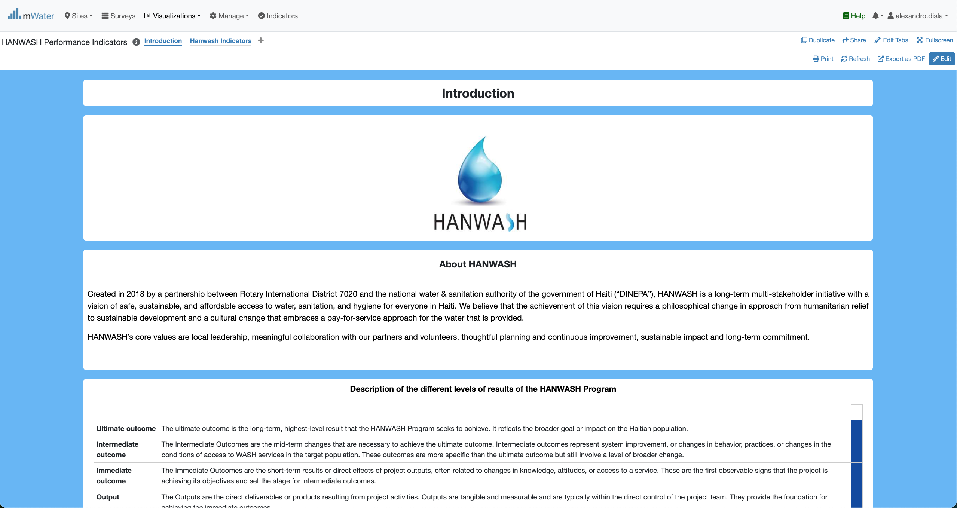
Print Export
The print option is available for a global export.

Slide 31
Print Export
The print option is available for a global export.

Slide 32
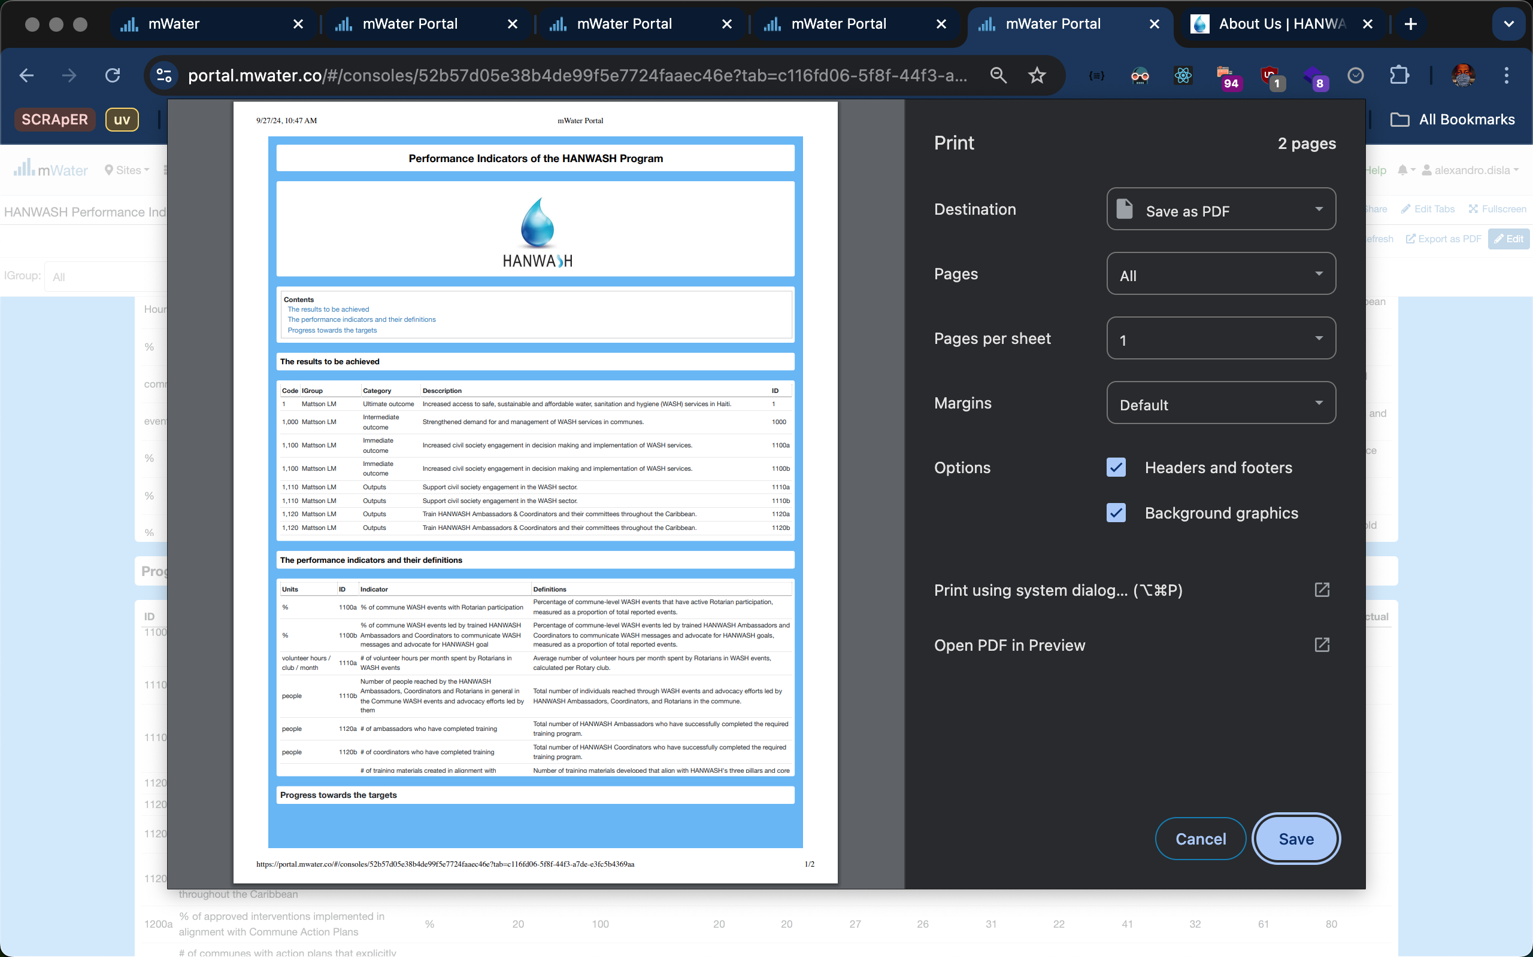
Print EXPORT

Slide 33
Thank You !!!
PLEASE FEEL FREE TO CONTACT ME BY :
Email / alexandro.disla@hanwash.org
Whatsap or Phone / +50941483700

